Slide 1
Software Architecture Process

Slide 2
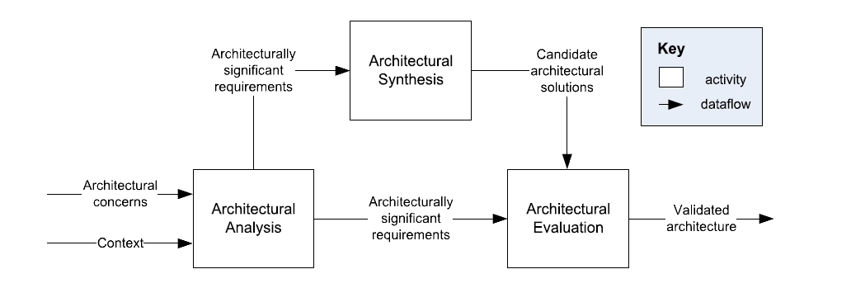
A General Architecture Process Model
C. Hofmeister, et al., A general model of software architecture design derived from five industrial approaches, Journal of Systems and Software, 80:106-126, 2007.

Slide 3
Architectural Analysis
Define the problems the architecture must solve.
Village – don’t build roads before understanding where people need to go.
Input: Architectural Concerns
Stakeholders’ interests that can impact arch decisions
e.g. hospital management system, what are stakeholders & interests?
Doctors – usability
Admins – log audit for compliance
Patients – secured access to PII
Ignoring leads to a costly redesign later

Slide 4
Architectural Analysis
Input: Context
Environment that will influence the system
  Ride-sharing application
  Developmental – team skills, available tools, budget constraints
    e.g. Team has a lot of expertise in Java, almost none in Go
  Operational – expected workload, runtime env, deployment platform
    e.g. Must handle large events (as concerts) – in one area, not just in total
  Political – company strategy, external regulations, stakeholder / department conflicts
    e.g. Must store user data in their country – legal regulations
  etc

Slide 5
Architectural Analysis
Output: Architecturally Significant Requirements
Requirements that influence architecture
  e.g.
    Performance – must handle 50k concurrent users
    Security – must be HIPAA compliant
    Availability – must achieve 99.99% uptime

Slide 6
Architectural Synthesis
Proposes architectural solutions to a set of ASRs
Village – sketch possible routes to solve main problems
Input: Architecturally Significant Requirements
Constraints & drivers
  ASR: must handle 50k concurrent users
    → distributed, scalable architecture
  ASR: must comply with HIPAA
    → secure data storage & audit logs
Having no ASRs leads to arbitrary decisions & developer preferences

Slide 7
Architectural Synthesis
Output: Candidate Architectural Solutions
Specific design solution
  Not necessarily final decisions
  Candidates should be realistic & feasible
  Multiple candidates can exist
  e.g., real-time chat application – what are possible approaches?
    Candidate 1 – monolith with WebSockets
    Candidate 2 – microservices with Kafka and push-notifications
Notes:
Monolith vs microservices+kafka vs serverless vs client mesh
Websockets vs push-notifications

Slide 8
Architectural Synthesis
Typical choices
  Structural
    Layered vs hexagonal
    Client-server vs peer-to-peer
      e.g. torrent protocol to distribute data across services
  Technological
    Relational vs NoSQL
    REST vs gRPC
  Cross-cutting
    Sticky sessions, OAuth2, JWT
    Logging & monitoring frameworks
Trade-offs
  Always present
    “It depends” ©
  Generate multiple candidates
  Evaluate & choose later

Slide 9
Architectural Evaluation
Ensure that the made architectural decisions are the right ones
Goal – verify alignment between ASRs & candidates
Village – check costs, safety, terrain & traffic before deciding what to build
Inputs
Architecturally Significant Requirements
Candidate Architectural Solutions
Output
Validated Architecture
  Subset of candidate architectures consistent with ASRs
    Some eliminated – failed to meet ASRs
    Some improved – refined to better satisfy trade-offs

Slide 10
Architectural Evaluation
Some techniques
  Scenario-based analysis
    Stress-test against hypothetical situations
    Find scenarios where system fails
    e.g. sudden traffic spike due to a marketing campaign
  Architecture trade-off analysis
    Find negative sides of architecture benefits
    Will it affect ASRs?
    e.g. a lot of caching → faster responses → weaker consistency
  Prototyping
    Build a throwaway prototype to test hypotheses
    e.g. Check if the architecture & technologies withstand 50k concurrent users
  Stakeholder review
    Different stakeholders focus on different aspects
    Warning – some stakeholders are not technical
Notes:
2 fundamental CS issues

Slide 11
Repeatable Architecture Processes
Repeatability – produce systematic results, not accidental (engineering)
Virtually every architectural methodology includes:
  Understanding the problem, gathering ASRs – analysis
  Proposing solutions – synthesis
  Validate against requirements – evaluation
Village – study, propose routes, validate routes (country road or highway)
Examples:
  Attribute-Driven Design
    Iterates over ASRs, choosing patterns/tactics that satisfy each quality attribute.
  RUP 4+1 Views
    Structures architecture around five complementary views
  Business Architecture Process and Organization (BAPO/CAFCR)
No one process is best – each has its strengths and weaknesses.

Slide 12
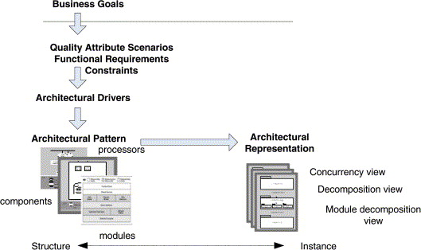
Attribute Driven Design
Built around architecture drivers — quality attributes ranked by business priority
Pros
  Traceable – every decision links to a driver
  Requirements explicitly shape an architecture
Cons
  Can overfocus on non-functional requirements
  Requires well-formed ASRs upfront – struggles when requirements are vague or evolving
  Can be heavyweight for small or simple systems
  Less prescriptive when multiple patterns satisfy the same ASR

Slide 13
Attribute Driven Design Process
Design Purpose
Primary Functionality
Quality Attributes
Constraints
Architectural Concerns
Step 1: Review Inputs
Step 2: Establish Iteration Goal
Step 3: Choose Elements to Refine
ADD applies iteratively — each pass selects one architectural driver and refines the design
From previous round of iterations OR from existing system
Step 4: Choose Design Concepts
Iterate if necessary
Step 5: Instantiate Architectural Elements
Step 6: Record Design Decisions
Step 7: Review Design
(Refined) Software Architecture Design

Slide 14
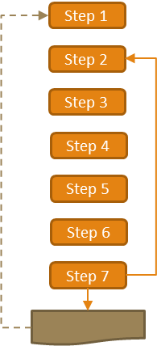
ADD Step 1
Review Inputs: Ensure the architecture drivers are available and correct
  Design Purpose
    Evaluate the opportunities
    Design the foundation fo the system
    Augment the current architecture
  Primary Functionality – Functionality that is critical to achieve the business goals
  Quality Attributes – Subset of QAs this round is focused on
    Expressed as QA scenarios (stimulus/response/measure); e.g. latency, security
  Constraints – Non-negotiable concerns
    e.g. existing systems, budget, technology, etc
  Architectural Concerns – Things that need to be considered as part of the architectural design, often not captured by traditional requirements
    Overall System Structure
    Allocation of modules to teams
    Issues that come from design reviews
Design Purpose
Primary Functionality
Quality Attributes
Constraints
Architectural Concerns

Slide 15
ADD Step 1
Example – E-commerce
Purpose – design a foundation for an online-shop
  Greenfield (new system)
Primary functionality – browsing & checkout
Quality attributes – "The system must handle 10× normal load during holiday peaks with <2s response time."
Constraints – must run on AWS
Concerns – payment and catalog will be created by different teams
  → potential communication issues
  → need to define clear APIs between these subsystems
Design Purpose
Primary Functionality
Quality Attributes
Constraints
Architectural Concerns

Slide 16
ADD Step 2
Establish Iteration Goal by Selecting Drivers
Waterfall's goal is to finish all architectural activities in one round
Iterative development (Agile) is multiple rounds
  → each round focuses on a specific goal
  First iteration goal depends on context
    Greenfield system in a mature field – e.g. select the overall Reference Architecture
      e.g. monolith vs microservices
    Greenfield system in a new, evolving field – e.g. develop a prototype architecture based on the key drivers
      Proof-of-concept – is the core architecture even feasible?
    Brownfield system – e.g. how the existing architecture extends to support the new functionality
  Later rounds may focus on a specific area – Security, Performance, etc. Where the specific area is based on the drivers
  Summary – define the goal & select corresponding drivers (narrow your focus)

Slide 17
ADD Step 3
Choose One or More Elements of the System to Refine
Make the choice based on the chosen drivers
  Identify the elements that require additional refinement
  Potential types of refinement:
    Decomposition
      e.g. checkout pipeline → basket, inventory check, payment, fraud detection
    Composition
      e.g. group Logging & Monitoring into a shared Observability subsystem
    Improve / extend existing elements
      e.g. add auth via Instagram to the designed / existing auth service
  First iteration
  Greenfield system - a system context diagram and refining / defining it
  Brownfield systems - may focus on what can be reused? Modified? Replaced?

Slide 18
ADD Step 4
Choose One or More Design Concepts that Satisfy the Selected Drivers
  Step 3 – where, step 4 – how
  Make architectural choices based on drivers
Sources of design concepts
  Reference Architectures – model architecture to solve a common problem
    e.g. event-driven architecture for an IoT data pipeline.
  Architectural Design Patterns – conceptual solutions to recurring design problems
    e.g. Command Query Responsibility Segregation (CQRS) for separating read and write workload
    e.g. microservices for independent deployability
  Deployment Patterns – how to physically structure a system for deployment
    e.g. load balancing, CDN
  Tactics – decisions that influence quality attributes
    e.g. encrypt data in rest, caching, redundancy + failover

Slide 19
ADD Step 4
Choose One or More Design Concepts that Satisfy the Selected Drivers
  Step 3 – where, step 4 – how
  Make architectural choices based on drivers
How to choose
  Traceability – does it serve the iteration goal?
    l
  Feasibility – is it possible with current skills & tools?
    Complex solutions vs coding monkeys
  Cost/benefit – what about trade-offs?
    Microservices are great… but bring a lot of architectural complexity
  Combinability – is it compatible with another concept we may want to use?
  Risk management – how risky is it? Stay with low-risk solutions
    e.g. nobody on the team implemented that pattern before? What are pitfalls?

Slide 20
ADD Step 4
Choose One or More Design Concepts that Satisfy the Selected Drivers
  Step 3 – where, step 4 – how
  Make architectural choices based on drivers
e.g. E-commerce checkout subsystem
  Driver – performance under load
  Concepts:
    Reference architecture: 3-tier model (presentation, logic, data)
    Deployment patterns: load balanced cluster for a checkout service
    Tactic: caching inventory queries
      → 3-tier model deployed as a load-balanced cluster, with caching at the data tier
  Result – high throughput, low latency
  Risks?
    Outdated inventory information due to caching
Notes:
Outdated inventory information due to caching

Slide 21
ADD Step 5
Instantiate Architectural Elements, Allocate Responsibilities and Define Interfaces
  Step 3 – choose elements → Step 4 – choose concepts → step 5 – apply in details
  e.g. chose microservices + API gateway, iteration 1
  API gateway – entry point & routing
  Order service – order lifecycle
  User service – profiles & auth
  Catalog service – products
  etc
  What interacts with what? How?
    → API Gateway routes REST calls to each service; Order Service calls Catalog (sync, product availability) and publishes to Notification (async, event)
Some aspects can be clarified & changed on later iterations
  Rate limiting in API gateway? Don’t know yet

Slide 22
ADD Step 6
Sketch Views and Record Design Decisions
Document it
  Ideas & whiteboard drawing → documentation & diagrams
  Document decision-making process
    Document why this concept was chosen over other – the rationale, not just the result
  Sketch relevant views — module decomposition, component-and-connector, deployment
  Why?
    Remind yourself
    Share with other architects & engineers to explain / discuss
    Future architects & engineers will know the context
      Can be changed during next iterations

Slide 23
ADD Step 7
Analyze Current Design
Review the architecture against
  Iteration goal
  Drivers
  Overall system goals
Drivers met, purpose satisfied → Next round!
Design purpose (round goal) not fulfilled → Next iteration!
Iteration drivers not met → Revise architecture, iterate again!

Slide 24
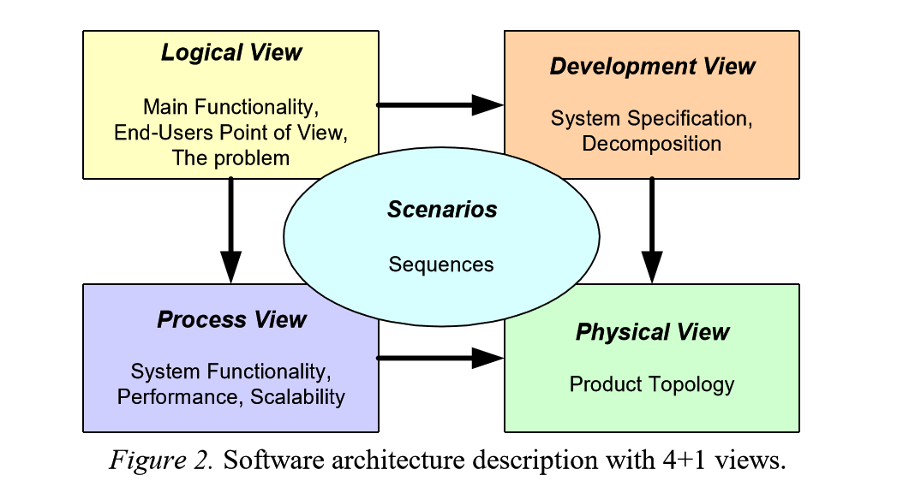
RUP 4+1 View
Architecture cannot be expressed in one view
  Each view addresses different stakeholder concerns
Logical
  Functionality – user’s PoV
  e.g. shopping cart, order, payment
  Stakeholders: analysts, designers, etc
Development
  Codebase organization
    Subsystems
    Module decomposition
    Libraries
    etc
  e.g. user-service, order-service
  Stakeholders: engineers, config managers

Slide 25
RUP 4+1 View
Arch cannot be expressed in one view
  Each view addresses different stakeholder concerns
Process
  Concurrency — threads, processes, runtime behavior under load
  Internal execution flow
  e.g. checkout flow
  Stakeholders: engineers, architects
Physical
  System topology / mapping to hardware
  e.g. multi-datacenter setup
  Stakeholders: devops, engineers, architects
Scenarios
  Use cases
  Tie 4 views together
  e.g. user login scenario exercises: Logical (auth module); Process (session management); Physical (load balancing)
  Stakeholders: all – scenarios are the validation mechanism

Slide 26
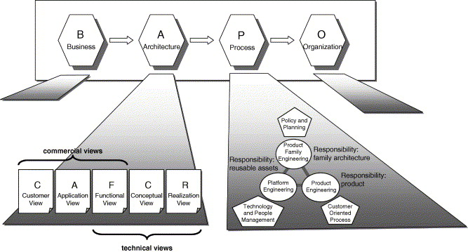
BAPO/ CAFCR
Why?
ADD & RUP 4+1 – focused on the technical aspect
Systems are created for businesses
  Business alignment
  Customer satisfaction
  Business processes
  etc

Slide 27
BAPO
Business – defines strategy / goals
  e.g. dominate the energy-efficient home device market
Architecture – translates those drivers into a system structure
  e.g. IoT thermostat with ML algorithms in the cloud
Process – defines how the architecture is built and evolved
  e.g. continuous deployment, rapid prototyping
Organization – who does the work + skills and roles
  e.g. IoT firmware team + devops team + ML experts
More high-level & business-oriented approach
  Use when business alignment is the primary concern and stakeholders are non-technical.

Slide 28
CAFCR
Customer view – customer's problem in need of a solution
  e.g. wants to reduce electricity bills
Application view – in what context the product will exist
  e.g. IoT thermostat interacts with HVAC and smart home
Functional view – features
  e.g. auto temperature adjustment, remote control
Conceptual view – key abstractions and building blocks of the system
  e.g. cloud-based ML, local device fallback
Realization view – implementation details
  e.g. microcontroller specs, OTA deployment pipeline, cloud infrastructure
CAFCR bridges business concerns and technical realization
  Use when aligning product roadmap to architecture

Slide 29
BAPO / CAFCR
Connected medical device
BAPO
  Business – regulatory compliance + patient trust
  Architecture – IoT + encryption + secure backend
  Process – FDA-regulated release cycle: design verification, validation testing, change control
  Organization – compliance officers + dev team
CAFCR
  Customer need – track blood sugar easily
  Application – integrates with medical systems, mobile app, and cloud analytics platform
  Functional – measuring + real-time data sharing
  Conceptual – reading, threshold, alert, synchronization as core domain concepts
  Realization – cell module + sim card + HIPAA-compliant backend

Slide 30
Product Delivery Process
Wider than initial architecture design
Pre-concept initiation
  What do we want to create / solve?
  Is it worth doing?
Concept initiation
  Shape a high-level solution
  Check it solves the need
  Check feasibility
Product initiation
  Establish metrics
  Validate feasibility by building a prototype
Development initiation
  Design, Implement, Test
Production / launch readiness
  Validate it’s ready
Launch / Wait
  Decision point – start or pause for fixes
Product validation
  Measure real-world performance
  Plan enhancements
Fleet upgrade / End-of-life
  Implement enhancements
  Discontinue

Slide 31
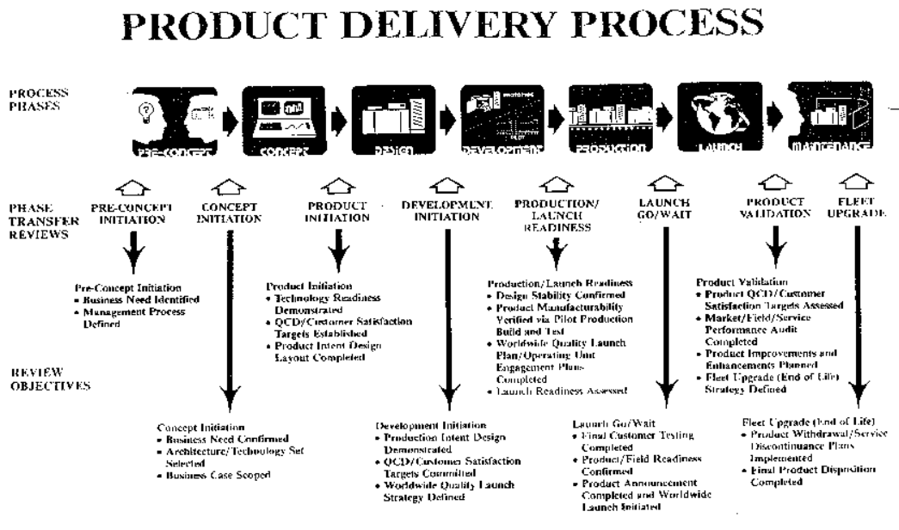
Notes:
Xerox Product Delivery Process, circa 1990s
Software Architecture was a dominant concern in the Concept Initiation and Product Initiation phases. Architecture would be well established by the start of Development.
Note the long lag time between identification of QCDs (Quality Targets) and validation.

Slide 32
Scenarios
Web application for banking
Describe a:
Performance Attribute
Security Attribute
Integrity Attribute
Availability Attribute
Control system for driverless car
Describe a:
Performance Attribute
Security Attribute
Safety Attribute
Reliability Attribute
10K concurrent requests
Reaction < 50ms
Remote connections encrypted & signed
Encryption in transit
Crash → transaction rollback
Sensor fail → full stop
99.99%
1000 hours between issues
What would be a good example of a Portability Attribute?
Mobile app (iOS/ Android)
Notes:
web
Performance – N concurrent requests
Security – encryption in transit
Integrity – crash => transaction rollback
Availability – 99.99%
Car
Performance – reaction < 50ms
Security – remote connections encrypted & signed
Safety – sensor fail => full stop
Reliability – 1000 hours between issues
Portability: Mobile app (iOS/ Android)

Slide 33
Examples
If you are building a desktop application
- Connects to online brokerage system
List some assumptions
List some dependencies
Notes:
Assumption: Have license to connect to brokerage system
Dependency: API documentation is available

